Slide 1

QuickFit: The Micro-Fitness App
By: Josh, Abdullah, Robert, Ishaan
Notes:
Josh will introduce the project and group members

Slide 2
Table of Contents
Introduction
Architecture
Users
Interfaces
Problem Statements
Design Patterns
Requirements
Design Principles
Use Cases
Testing Plan
SDLC Model
UI/UX
Notes:
For deployment, we could say how we are going to use horizontal/vertical deployment

Slide 3
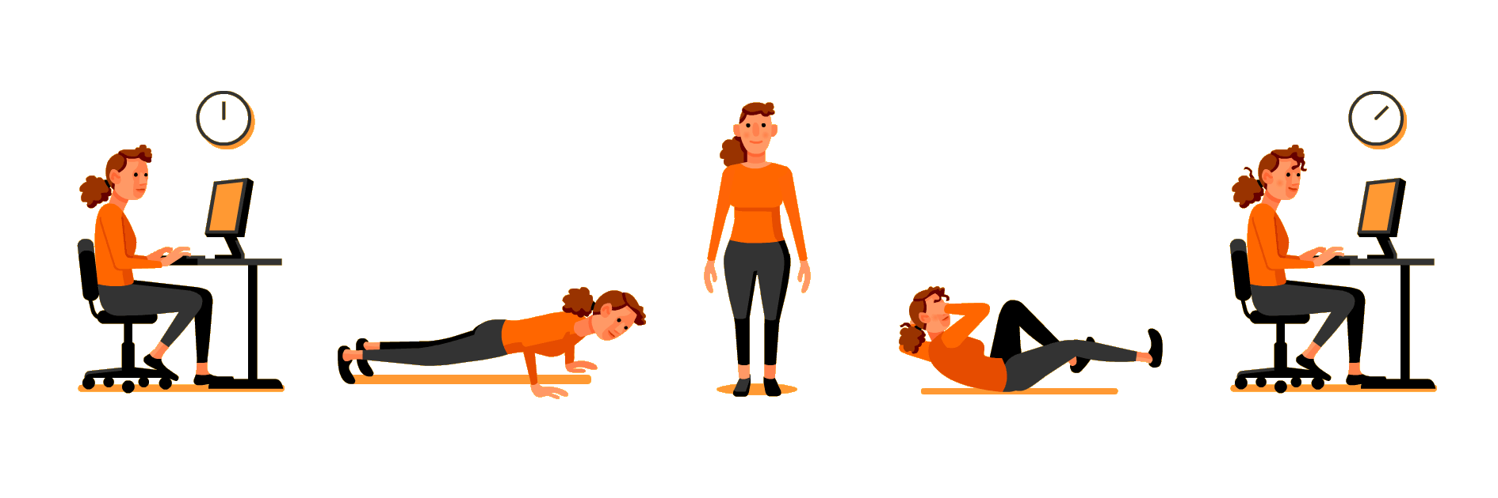
Introduction
QuickFit is a micro-fitness app designed to help maximize activity done throughout the day.
Our objective is to motivate people to live a healthy life by working out in short bursts throughout the day. “No time? No problem! Get QuickFit”. We encourage doing physical, mental, and stretching exercises to keep the body active!
Notes:
Josh will break down the introduction

Slide 4

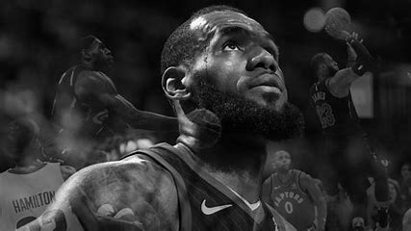
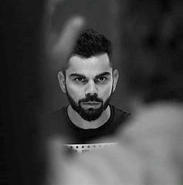
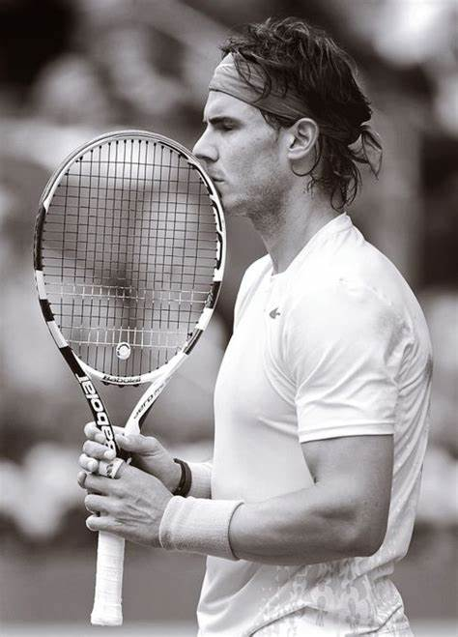


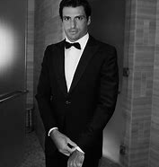
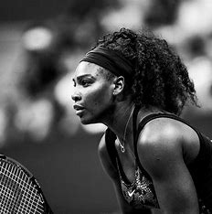
Users
Customers:
People using the app to do short burst exercises
Admin:
People who responsible for developing and maintaining the app
Notes:
Josh can do users and expected audience

Slide 5
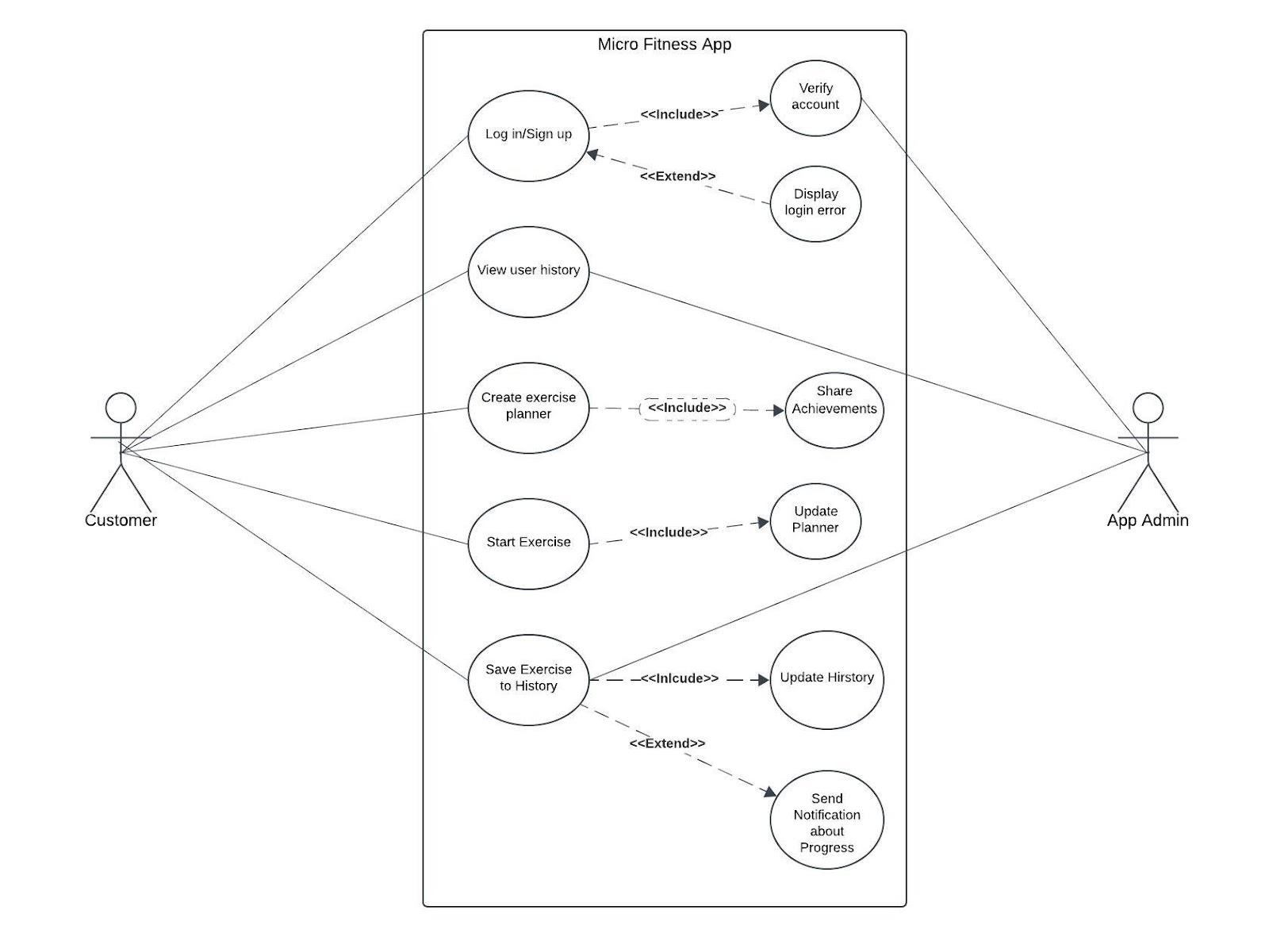
User Diagram

Slide 6
Problem Statement
01
Clark Kent is a software engineer at the Daily Bugle and works remotely. He wants to workout to strengthen his muscles and core, but is unable to do so due to frequent work meetings.
02
Bradley Martyn is a workout influencer on Instagram. He uses QuickFit to exercise and wants to motivate his followers to exercise by following his example.
03
Gwen Stacy wants to exercise regularly but loses motivation when working out alone. Her friends, Peter Parker and Harry Osborn, are in similar positions and slowly stop working out to due life stresses.

Slide 7
Requirements
Functional
Non-Functional
Secure user authentication
User has access to a wide range of exercises to choose from
Ability to be recommend workouts based on input
Display timer during workout
Allow offline workout download
Quick access to the timed workout session
Easy to navigate / simple design
Scalable for 10,000+ users
Reliable
Compatible with Apple and Android with built in watch app

Slide 8
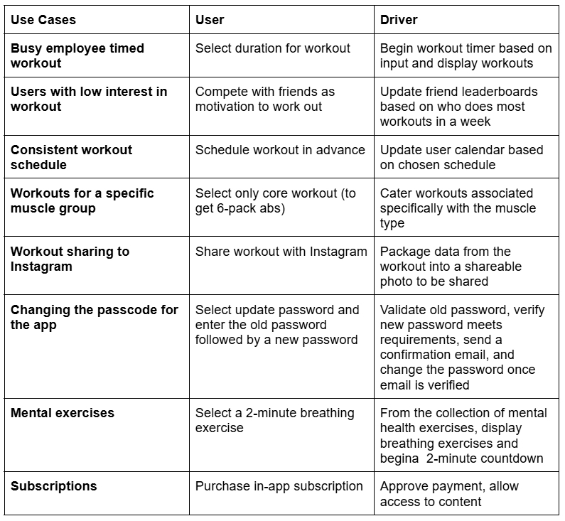
Use Cases
8 cases described also cover solutions to the problem statements

Slide 9
Incremental Agile SDLC Model
Why we chose this model
Faster delivery of Usable Features
04
While we had knew our main specifications, we wanted to make it easier to implement new features through the process
Users get early access to the app with basic functionality, allowing you to generate interest, gather feedback, and verify functionality
01
03
Adaptability to User Feedback
Prioritize essential features
Agile allows you to incorporate user feedback after each increment, validating the app to align with our requirements
This approach allows us to prioritize essential features initially and introduce advanced features over time
02

Slide 10
Incremental Cycles
1
2
3+
04
04
04
Introduce essential features
Optimize through user feedback
Implement user feedback
01
03
01
03
01
03
02
02
02
Timer & basic workouts selection for physical workouts
Remaining workout categories, user profiles, and API integration (Instagram sharing)
AI recommendations, analytics, offline mode, friends leaderboards, and more

Slide 11
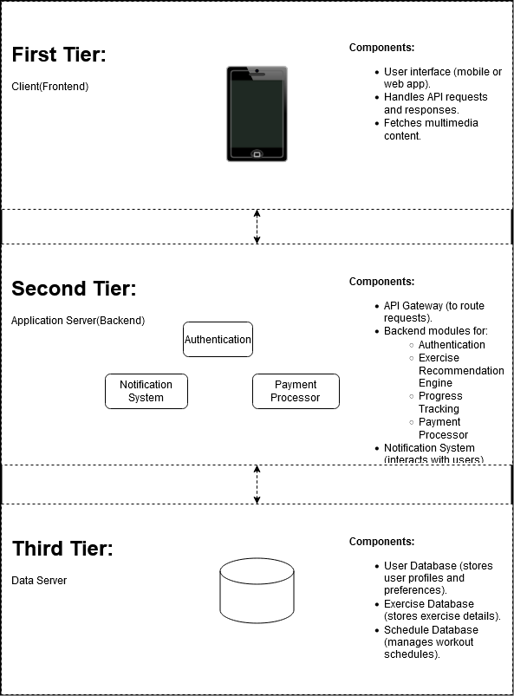
Client Server
Architecture
Architecture Diagram
QuickFit uses a three-tier client-server architecture, separating the system into Client (Frontend), Application Server (Backend), and Data Server (Databases) to ensure modularity, scalability, extensibility, security and maintainability.
A client-server architecture with horizontal scaling also allows system reusability across different servers. Updates made to one module can be applied across all servers.

Slide 12
Architecture cont…
Frontend provides the user interface, captures input, and communicates with the backend via the API Gateway for tasks like fetching workout routines, logging progress, and receiving multimedia content from the CDN.
Backend processes business logic, including authentication, exercise recommendations, progress tracking, and notifications. It also manages payment processing and interacts with databases to retrieve or store data.
Databases store user profiles, exercise metadata, and workout schedules, ensuring efficient and secure data management.

Slide 13
Interfaces
Backend
UpdateApp( : bool)
ChangePassword(password old, password new : bool)
SaveProgress(calendarDate date, double duration, workout session : bool)
LoadProfile(user profile_name : bool)
GetExerciseTypes(string workout_type : workout)
FindExercises(workout session : workout)
Frontend
BeginWorkout(double time, workout workout_type : bool)
GetWorkoutTime(vector<double> time_options:double)
ShareWorkout(double duration, workout session, system instagram_id : image)
GetScheduleDays(vector<string> days : vector<string> )
GetScheduleDuration(vector<double> times : double)
CreateSchedule(vector<string> days, double duration : calendar)
GetPhysicalWorkout(string muscle_type : vector<string>)
GetMentalHealthWorkout(string mental_type : vector<string>)
GetStretchingWorkout(string stretching_type : vector<string>)
PurchaseSubscription(money amount, string subscription_type : bool)
Notify(notification message_alert : bool)
Payment Processor
InitiatePayment(money amount, user profile_name, string subscription_type : bool)
Authenticator
Login(string username, password code : bool)
Logout(user profile_name:bool)
2FA(user profile_name, string email_id : bool)
Notes:
Highlight & pop out few example interfaces

Slide 14
Design Patterns
Workout
Factory
Physical Workout
Mental Health Workout
Stretching Workout
Factory Pattern: Encapsulate the creation process of Physical, Mental Health, and Stretching Workout objects. The base workout object will act as a template for the other types of workouts.
Singleton Pattern: Combine workout logs in one location to optimize analysis and workout recommendations
Strategy Pattern: Use in the backend to suggest workouts based on selected duration and category

Slide 15
Design Principles
Separation and Modularity for Loose Coupling: By designing system components with unique, self-contained methods (e.g., getWorkoutType(), getExerciseType()), we ensure loose coupling, allowing individual components to scale or be replaced without impacting others. This reflects Separation of Concerns and Single Responsibility, as each method focuses solely on its task while promoting a clear, maintainable structure.
Extensibility: The design of this system has clear separation of concerns and error-handling mechanisms while supporting extensibility. Separated components can be modified and extended, and more components can be introduced to the system.
Scalability, Extensibility, and Reusability through Generality and Open/Closed Design: Methods like findExercises() can handle generalized parameters and return consistent types, supporting reusability and modularity. New functionalities, such as adding exercise categories or modifying a workout type, can be integrated seamlessly without altering existing components, adhering to the Open/Closed Principle.
E.g. Interfaces like GetWorkoutTime(vector<double> time_options:double) and workout objects use vectors over arrays to allow additional time and workout category options.

Slide 16
Testing Plan
Our interfaces must be able to match the non-functional requirements of the user: For example:
BeginWorkout() is tested to be successful if the return correct workout
This method will considered failed if it returns the improper workout type or null
Inputs: Time (double), workout type (object), duration (vector<double>), and Instagram ID (system input)
Outputs: Boolean success indicators, images, or errors handled appropriately
Reporting Mechanisms:
Test results will be recorded in a shared GitHub repository
Bugs will be logged in an issue tracker (e.g., Jira) and assigned to relevant team members

Slide 17
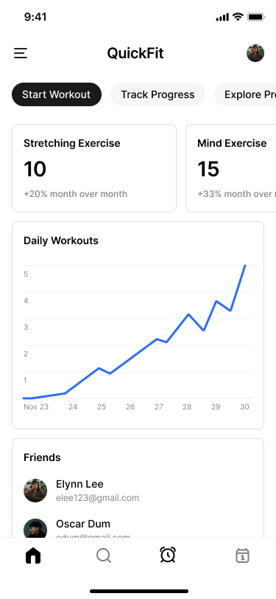
QuickFit Home Screen
Spotlight on mobile
QuickFit app home screen highlights quick access, a key non-functional requirement, with intuitive navigation buttons like "Start Workout" and "Track Progress." The design ensures usability and responsiveness with features like detailed stats, a Daily Workouts tracker, and a "Friends" section for engagement. The clean layout enhances accessibility and efficiency, meeting user needs effectively.
Notes:
Could show phone UI

Slide 18
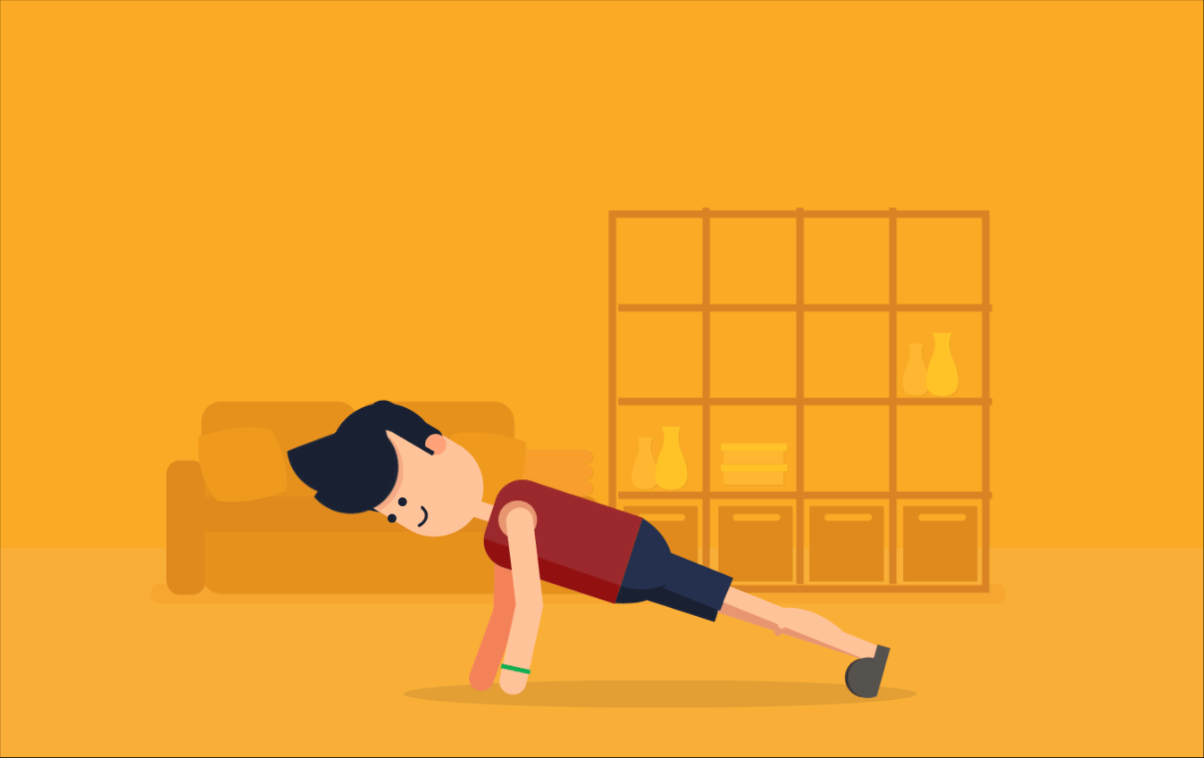
Thank you!

